Slide 1
Transient flow to wells

Slide 2
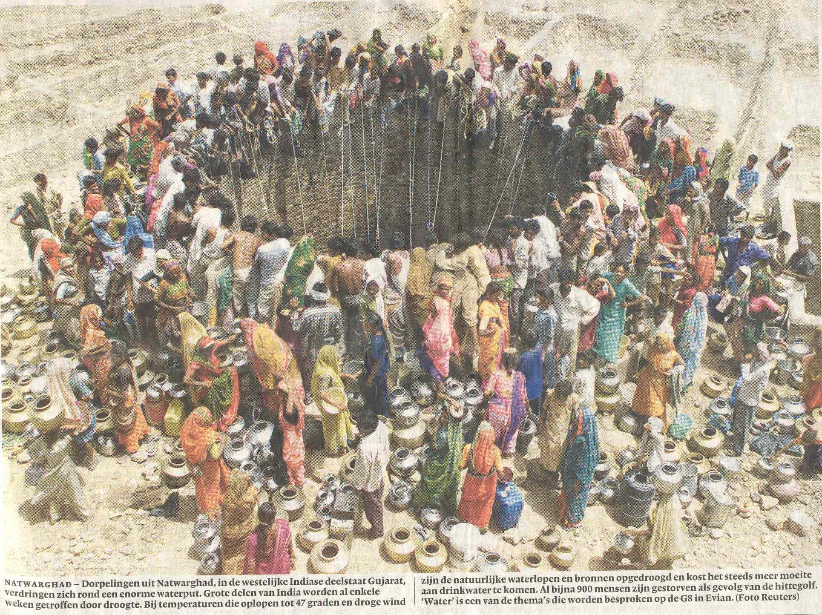

Slide 5
Governing partial differential equation

Slide 6
arbitrary datum

Slide 7
Q
s
c
kH
S
r

Slide 8
Hantush (1955)
Transient radial symmetric flow towards a well
in a semi-confined aquifer
Q
φ
s=φ-φ_{o}
φ_{o}
c
kD
λ²=kDc

Slide 9
Q
s
S_{y}
h
k
r

Slide 11
Exercise
Drawdown by for wells in a square with sides of L = 1 km
Task
First well starts at t=0 d
Second wel at t = 365 d
Third well at t = 730 d
Fourth well at 1095 d
kD = 600 m2/d
Sy = 0.24
Q = 14400 m3/d
Compute and show the drawdown in the center of the square as a function of time up to t=10 years.
Compute and show the drawdown on a grid as contour lines

Slide 12
Well1 (14400 m³/d from t=0)
Well2 (14400 m³/d from t=365 d)
1000 m
Well4 (14400 m³/d from t=1095 d)
Well3 (14400 m³/d from t=730 d)
1000 m

Slide 13
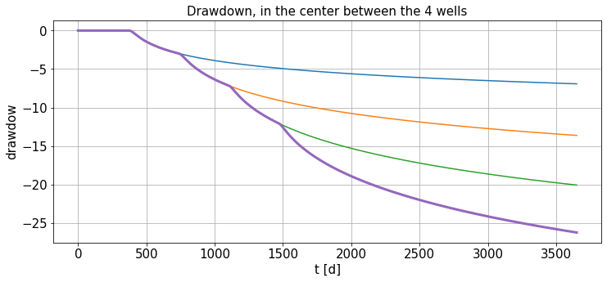
Drawdown in the center of the square over time

Slide 14
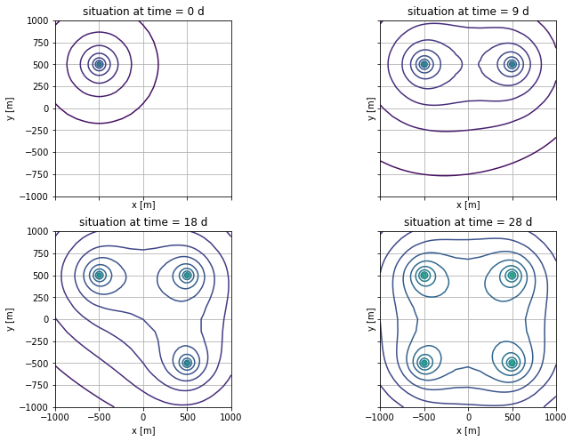
Drawdown contours

Slide 15
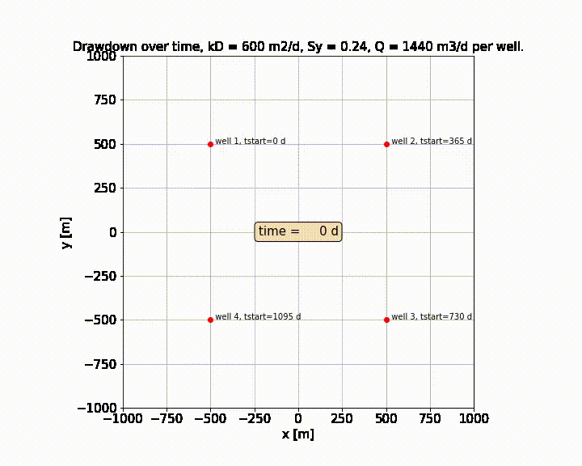

Slide 16
Excercise
Properties
Task
5 wells in a row at x=0 and y = [-180, -80, 0, 80, 160] m extracting 240 m3/d each.
kD = 600 m²/d
S_{y} = 0.22
c = 200 d
Compute the drawdown along the xaxis (y=0) for several times up to 1000 d
First using Theis drawdown
Second using Hantush

Slide 17
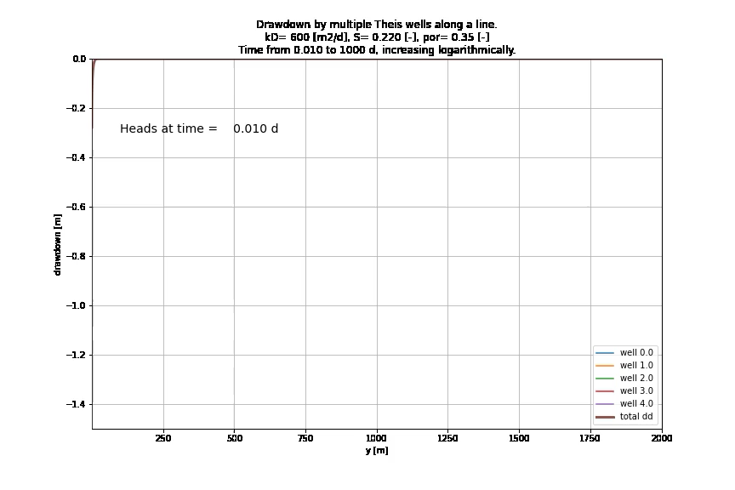

Slide 18
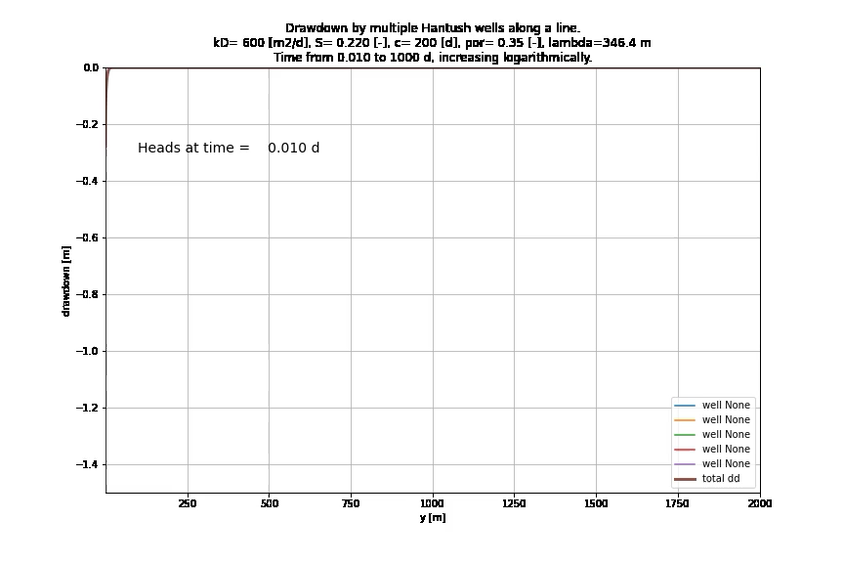

Slide 19
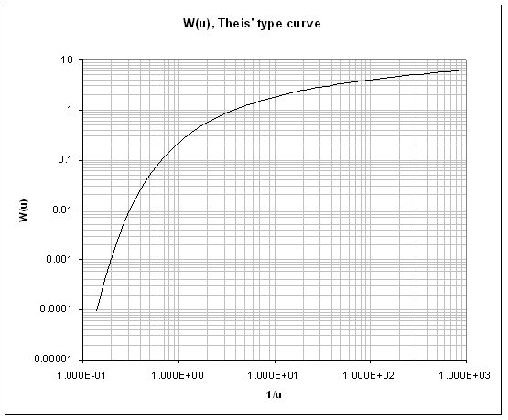
Match point

Slide 20
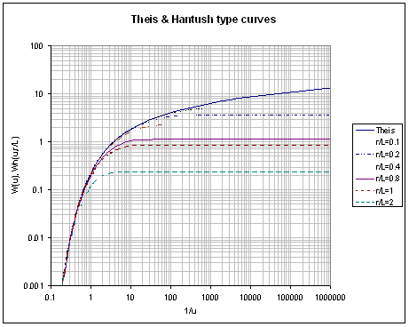
Match point

Slide 21
Match point

Slide 22
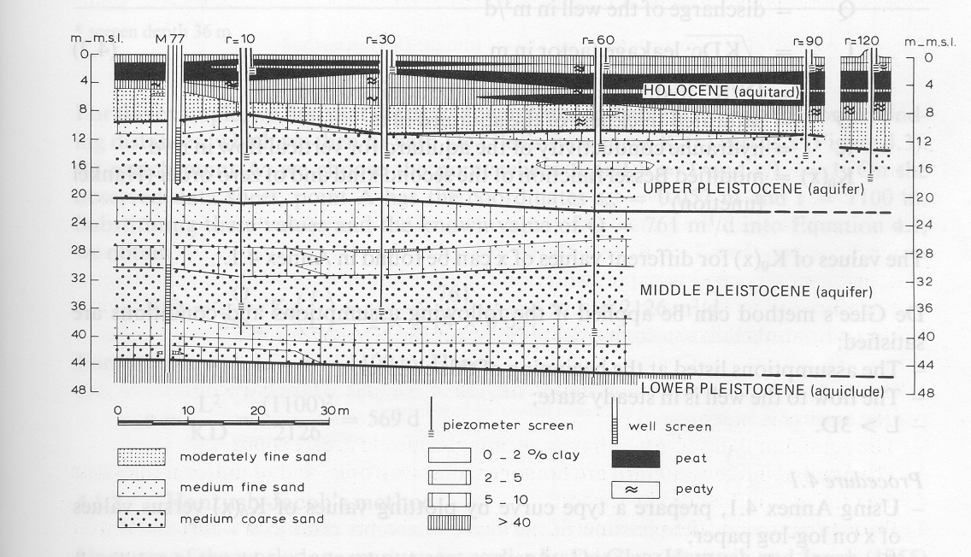

Slide 23
Measuring from above
Measuring from below
b
a
z
D
a
r
r
b
z

Slide 24
r_{c}
k
r_{w}
h
r

Slide 25
Key questions
Can you derive the elastic storage coefficient of aquifers?
Same for barometric efficiency?
Same for effect of overburden change?
How do barometric efficiency and overburden efficiency relate to each other?
How can specific storage coefficient be derived from measured barometric efficiency?
How does specific storage relate to elastic storage of an aquifer?
Have any idea of values of specific storage found in practice?
Same for specific yield of sand?
What is the dimension of specific yield S_{y}, specific storage S_{s} and elastic storage S?
Which of the two is largest (specific yield or elastic storage, and how much larger?)
For the cracks: could you derive the effect of earth tide on groundwater head?

